Slide 1
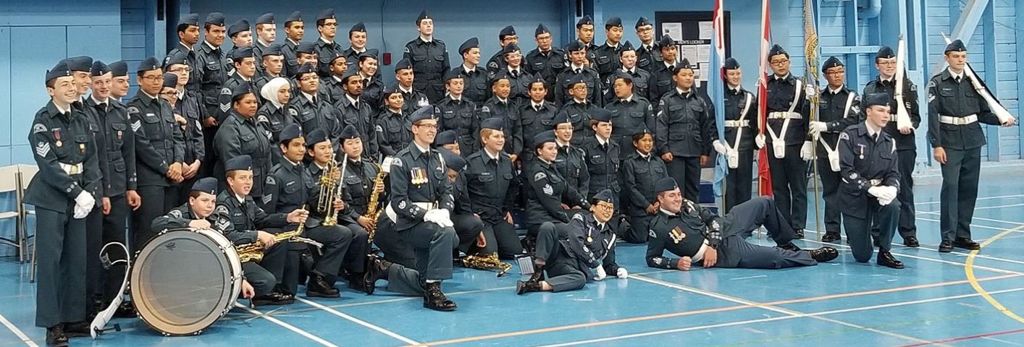
Welcome to 191 RCACS!

Slide 2
Follow the Link (requires sound):
https://www.youtube.com/watch?v=9SgcCGb3Tco

Slide 3
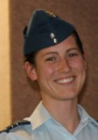
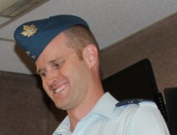
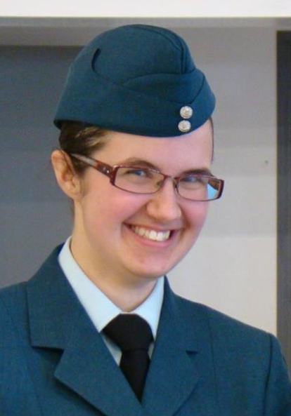
Staff Introductions Cont.
Commanding Officer (CO) & Biathlon Coach
– Captain (Capt) Jessica Fichtner
Training Officer & Deputy Commanding Officer
– Lieutenant (Lt) David MacDonald
Assistant Training Officer – Lt Rebecca Harris

Slide 4
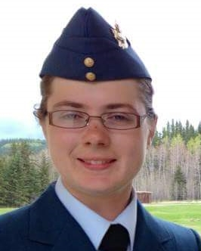
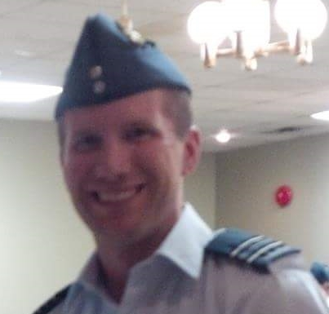
Staff Introductions Cont.
Administration Officer - Lieutenant (Lt) Bailley Strom
Level 3 Officer & Assistant Biathlon Coach
- Captain (Capt) Andrew Fichtner

Slide 5
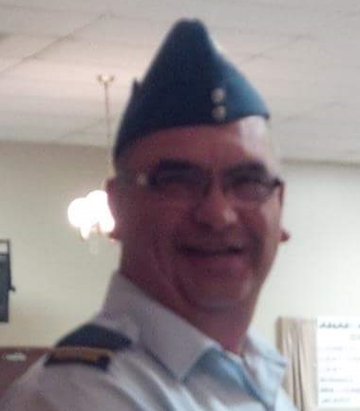
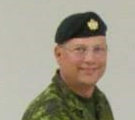
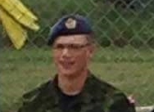
Staff Introductions
Supply Officer (SupO) & Marksmanship Coach
Lieutenant (Lt) Don Sul
Standards Officer (StdO) & Level 5 Officer
Captain (Capt) Brad Penner
Level 2 Officer & Flag Party/Drill Team Coach
Lieutenant (Lt) Tyrone Penner

Slide 6
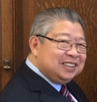
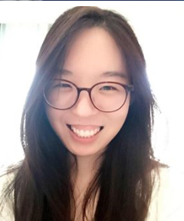
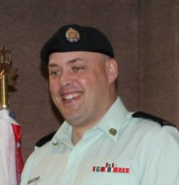
Staff Introductions
Band & Effective Speaking Officer
Civilian Instructor (CI) Howard Mar
Level 1 Officer & Korean Translator
Civilian Volunteer (CV) Elizabeth Shin
Level 4 Officer and Assistant Marksmanship Coach
Sgt. Tyler Davey

Slide 7
What We Do
Tuesday Night Parades
Opening Parade
Classes (Three periods of half hour each)
By Level
New Cadets generally Level 1
14 years of age by Aug 31, 2019 -> Level 2
15+ years of age by Aug 21, 2019 -> Level 3
Aviation, General Cadet Knowledge, Leadership, Citizenship, Aerospace, Drill, Effective Speaking, Marksmanship etc.
Lots of hands on activities
Break – canteen and time to visit with other cadets
Closing Parade
Uniform Inspection
Sports Nights every 1-2 months
CO Parade every first Tuesday of the month

Slide 8
What We Do
Weekend Training
About once a month there is weekend training
These are mandatory activities
These include:
Gliding
Survival
Skills Day, Leadership Day, Sports Day etc.
Volunteering & Fundraising
We try to do volunteering in the community once per month
Fundraising is the reason that the program is offered for free

Slide 9
What We Do
Extra-Curricular (Optional Activities)
Sunday:
Marksmanship (1:00 – 4:00 PM)
Effective Speaking (7:00 – 9:00 PM)
Drill Team (4:00 – 5:30 PM)
Flag Party (4:00 – 5:30 PM)
Band (1:00 – 4:00 PM)
Other Days:
Biathlon (Sunday & Thursday evenings)
Ground School (Wednesday evenings)
*Timings approximate, will be confirmed in coming weeks*

Slide 10
Summer Camp
1st year cadets have the opportunity to go to General Training Course in Cold Lake, AB
2 Weeks (Generally first two weeks of July)
*Show video of Life of a General Training Cadet*
https://www.facebook.com/ColdLakeCadets/videos/1566026800124034/
Further camps include
Survival
Sports
Drill and Leadership
Band
Aviation & Aerospace
International Air Cadet Exchange (IACE) for senior cadets
Gliding and/or Power Pilot Scholarships
Staff Cadet

Slide 11
Summer Camp Cont.
Application for camp occurs December - January
Each squadron is assigned a certain number of spots for summer camp
Not everyone gets accepted to camp
Cadets apply, Officers provide nominations, Air Training at the base selects cadets
Nominations for cadets to go to camp is based on attendance, uniform, discipline, participation in optional activities and any other relevant criteria
Those at the top of their levels in these areas are the most likely to be awarded a camp

Slide 12
Expectations
Attendance
Cadets are expected to attended all Tuesday night parades and all mandatory training
Minimum 60% Attendance, survival exercises and one gliding day
Higher attendance is required to get the most out of the program
You must either submit an absence form on the website or call the squadron to received an excused absence

Slide 13
Expectations
Uniform
You will be issued a uniform and you will be expected to maintain it to set standards.
If you are unable to wear your uniform, you are expected to be dressed professionally.
Dress Pants, Black Pants or Khakis
Issued 191 RCACS or Blue T-Shirt. If you do not have one of these then a polo shirt, dress shirt or equivalent
Follow up with Supply every couple of weeks for the status of your uniform

Slide 14
Expectations
Discipline
We expect all cadets to act in a professional & respectful manner
Address all officers with Sir or Ma’am
Salute if you are wearing a wedge
Pay attention in class
Be a role model for your peers
Younger cadets will look up to you, like you look up to the older cadets
Expectations are the same for all cadets whether in 1st year or in 5th year. Following these expectations increases your chances for promotion, awards, and camps.

Slide 15
Expectations
Follow Orders from Officers, Civilian Instructors and Senior cadets
Adhere to your rights and responsibilities (on following slides)
Be accountable for your actions/decisions
Support other cadets when able
Do not leave early for any reason from a cadet activity unless authorized by the Officer in charge

Slide 16
Cadet Responsibilities
Treat others with respect
Do NOT exclude anyone
Help protect others
Respect personal boundaries; honor NO’s
Tell the truth
Listen
Do not Misuse power / authority
Control Anger
Do not harass anyone
Do not abuse anyone

Slide 17
Cadet Rights
As a Cadet you have the following rights:
To be treated fairly
Belong
Feel Safe
Be Included
To learn
To seek help if you need it
To be heard
To make decisions
to be protected from harassment, criminal offences and child abuse
To say NO to unwelcome behavior
Code of Conduct to be signed with application

Slide 18
Parent Involvement
Air Cadets is funded by a partnership between DND and the Air Cadet League of Canada
Parents Committee is the local level of the Air Cadet League
Parents Committee is crucial to the success of our squadron
Parents meetings occur once a month
First Tuesday of the month from 8:30 – 9:00 PM
This is the same night as CO Parade so you can watch
Parents committee is responsible for:
liaising with the Air Cadet League of Manitoba (Provincial Level of the League)
Helping set up fundraisers
The more parents that get involved, the less work there is for everyone to do!

Slide 19
Communication
Website – www.191rcacspa.ca
Official mode of mass communication
All updates and scheduled events posted
Use this as your first resource for answering questions
Calendar of events, Excused absence form, many other resources
Facebook – 191 Royal Canadian Air Cadets
Primarily for cadets to discuss with one another
Photos of activities are shared
The Facebook page is NOT a means to harass, put down or otherwise hurt the staff or Cadets (this has happened in the past and will not be tolerated)
We have a Closed Facebook Group for all current cadets and their parents. We also have a Public Facebook Page to help promote the squadron

Slide 20
Communication
Instagram - @191rcacs
Pictures and videos are shared
Twitter – @191rcacs
Pictures and videos are shared
Other cadet activity and cadet related activity is retweeted

Slide 21
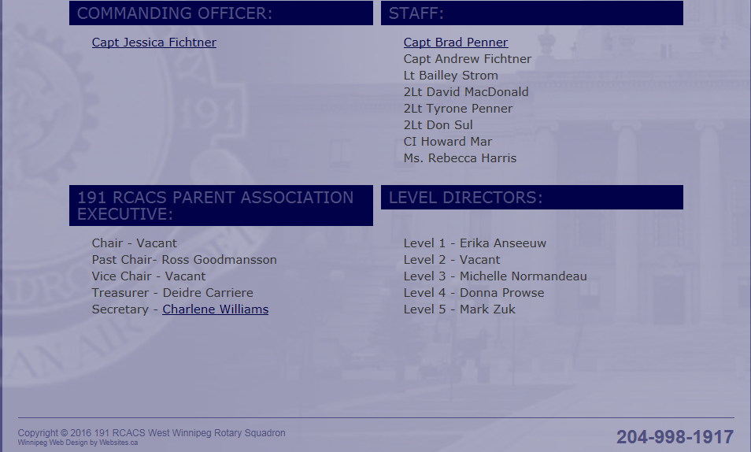

Slide 23
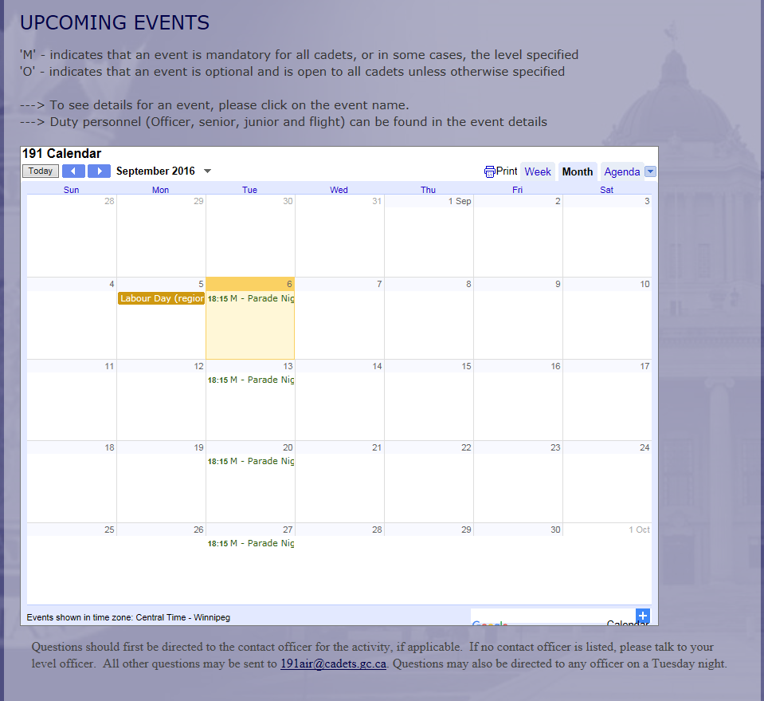

Slide 24
Communication
Cellphone – 1-204-998-1917
Will try and respond to voicemail as soon as possible
Email – 191air@cadets.gc.ca
Response typically within 48 hours from an officer
Staff
Officers are available to answer questions on Tuesday nights
Cadets can also talk to any senior cadet if they have questions

Slide 25
Welcome To 191 RCACS!
Any Questions?

